Slide 1

CRM BANK PROJECT
JATIN KUMAR

Slide 2

Problem statement
Utilize customer demographics, transaction details, exit information, and active profiles to reduce churn, enhance service delivery, and improve customer satisfaction.
Approach:1.Analyze datasets to identify churn predictors and customer segments.
2.Implement visual to identify the churn and personalize interactions.
3.Measure success through churn reduction and different metrics

Slide 3

INTRODUCTION
RowNumber: The row number in the dataset, likely used for reference or indexing.
CustomerId: A unique identifier for each customer.
CreditScore: A numerical representation of the customer's creditworthiness.
Credit score:
Excellent: 800–850
Very Good: 740–799
Good: 670–739
Fair: 580–669
Poor: 300–579
GeographyID: A numerical identifier that likely corresponds to a geographical location, such as a country or region.
GenderID: A numerical identifier for the customer's gender, where for example, '1' could represent male and '2' could represent female.

Slide 4
Age: The age of the customer.
Tenure: The number of years the customer has been with the bank.
Balance: Current balance in the customer's account.
NumOfProducts: refers to the number of products that a customer has purchased through the bank.
HasCrCard: denotes whether or not a customer has a credit card. This column is also relevant, since people with a credit card are less likely to leave the bank.
1 represents credit card holder
0 represents non credit card holder
IsActiveMember: active customers are less likely to leave the bank (as per the criteria defined by the bank for identifying the activeness).
1 represents Active Member
0 represents Inactive Member
Estimated Salary: as with balance, people with lower salaries are more likely to leave the bank compared to those with higher salaries.
Exited: whether or not the customer left the bank.
0 represents Retain
1 represents Exit

Slide 5

Customer Churn and its impact on business
Customer churn, the rate at which customers stop using a company's products or services, is a crucial metric for banks.
It directly impacts revenue and profitability.
In this presentation, we will analyze our bank's customer churn rates, focusing on gender, recent years, customers with credit cards, number of products used, credit score-wise churn count, and geography-wise churn count.
Our goal is to identify factors contributing to churn and propose strategies to improve customer retention and satisfaction

Slide 6

DATA OVERVIEW
The dataset comprises seven tables including "Customer Info," "Churn," and "Active Customer," offering comprehensive insights into customer demographics and banking metrics.
"Customer Info" contains vital details like customer IDs, age, and estimated salary, forming the foundation for analyzing customer behavior and churn patterns.
Metrics such as account balances, tenure, and product holdings provide insights into customer engagement and financial behavior, aiding in churn prediction.
Predominantly categorical variables enable segmentation by geographic regions, gender, and credit score brackets, while continuous variables offer deeper analysis potential.

Slide 7

OBJECTIVE ANALYSIS

Slide 8
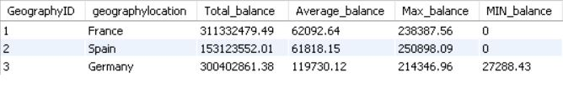
Account Balance Distribution
The SQL query computes the distribution of account balances across different regions by joining table’s customer info, geography, and churn. It calculates the total balance, average balance, maximum balance, and minimum balance for each region. The results reveal the distribution of account balances for France, Spain, and Germany, showcasing their total balances, average balances, maximum balances, and minimum balances.

Slide 9


Churn rate by Gender
male
15.37
The churn rate for females is 25.0488%, whereas the churn rate for males is 15.3716%.
Overall, the churn rate for females is higher than the churn rate for males in the dataset you provided.
Female
25.05

Slide 10

Gender-wise Income and Active Accounts:
Females have a higher average estimated salary ($100,601.54) than males ($99,664.58) in this. However, the table also shows that there are more active accounts for males (2,867) than females (2,284).

Slide 11
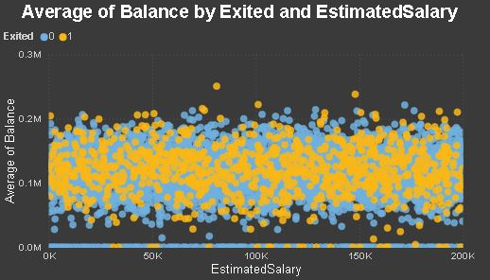
Correlation Between salary and balance
There appears to be a positive correlation between the average balance and the estimated salary. This means that customers with a higher estimated salary tend to have a higher average balance.
The data points are scattered around a general upward trend. This suggests that there is a relationship, but it is not a perfect one. There are many customers who deviate from the trend.

Slide 12

Subjective Insight's

Slide 13
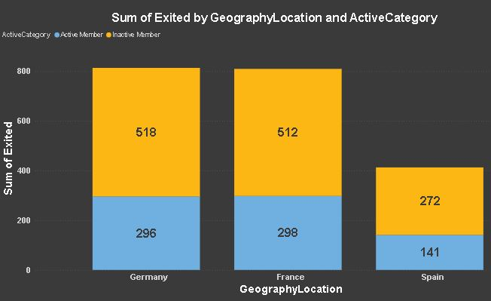
Subjective Insight's
Economic indicators in different geographic regions
There are more exited inactive members than exited active members in all three geographic locations. This suggests that inactive users are more likely to churn (stop using the product or service) than active users. This could be for a number of reasons,

Slide 14
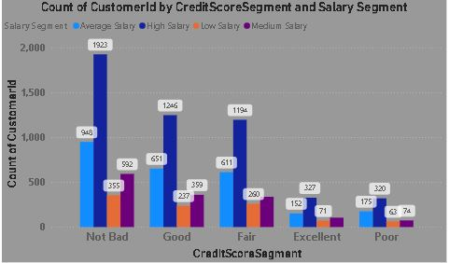
Risk Management Assessment
Salary Segment: This column shows the salary brackets for the customers. The brackets include Low Salary, Medium Salary, High Salary, and Not Disclosed.
Credit Score Segment: This column shows the credit score brackets for the customers. The brackets include Poor, Fair, Good, and Excellent.
Count of CustomerID: This table shows the count of the number of customers in each combination of salary and credit score bracket. For instance, there are 237 customers with a Low Salary and a Poor credit score.

Slide 15
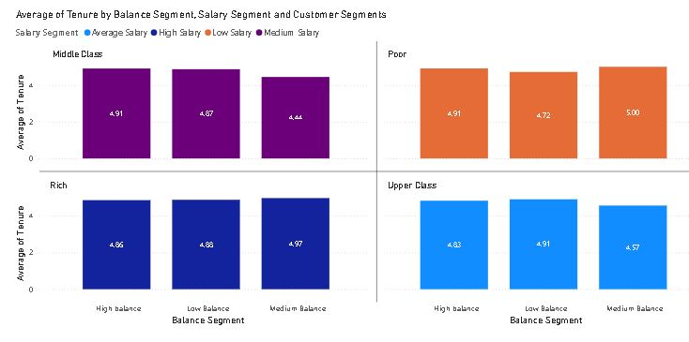
Customer Tenure Value Forecast
High-value segments: Customers with high salary and high balance tend to have the longest tenure (4.88 years on average). This suggests that this segment may be the most valuable to the bank.
Tenure by wealth: Looking at just the rich category, high balance customers still have a higher tenure than low balance customers (4.97 years vs 436 years). The same pattern holds for middle class and poor classifications.
Tenure by salary: Within each balance category (high, medium, low) customers with high salary have a longer tenure than those with lower salaries.

Slide 16
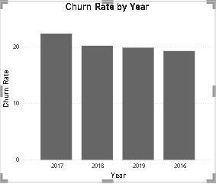
Churn rate per year
Churn Rate:
The overall churn rate for the bank is 20.37%.
Year-on-year churn rates show some fluctuations:
2016: 19.27%
2017: 22.35% (highest)
2018: 20.21%
2019: 19.86% (lowest)

Slide 17
Conclusion
If as compared to the appointment fees taken by the doctors to the total revenue earned by hospital, it can be said that the hospital is profitable. As the total fees by the doctor is 5.35M. thus by excluding that from the total revenue determines the profitability.
•There is a one-to-many relationship between the doctor id and department, as each doctor is assigned to single department. Like one doctor is associated to single department. There is no single doctor who are assigned to multiple departments.
•The hospital management should offer discounts to the patients of the age group of 60 (60-70) & (above 70). As they are seniors and need more assistance as compared to the youth generations, thus it will help in increasing the satisfaction score of patients and there can be increase in the patients of this age group also
•The strategies we could use to provide discounts to the patients should be like giving 50% discount in the appointment fees of doctor to all the seniors category of 60 (60-70) & above 70. And we can also provide extra free facilities to the senior citizens like massage area or free regular tests. Thus, it will not increase the number of patients but also increase the satisfaction score of patients by attracting new patients.

Slide 18
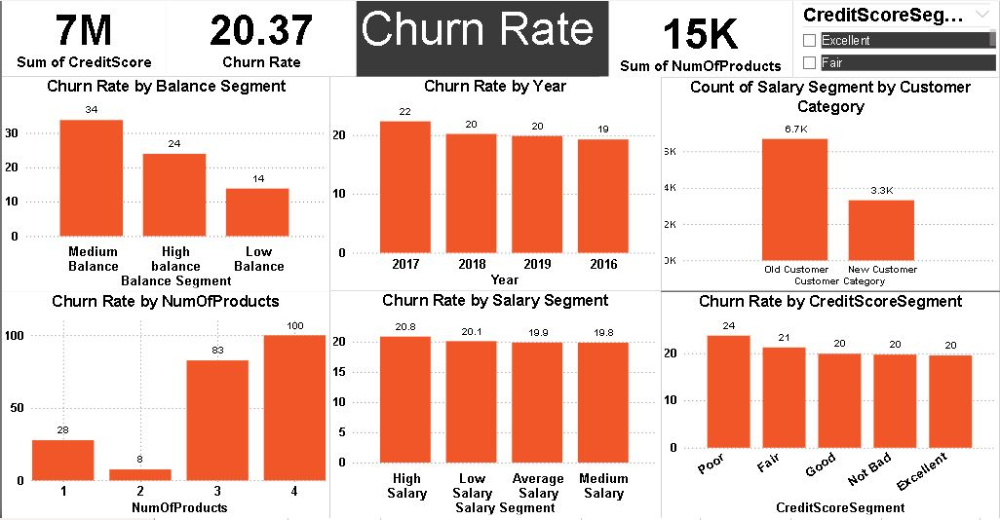
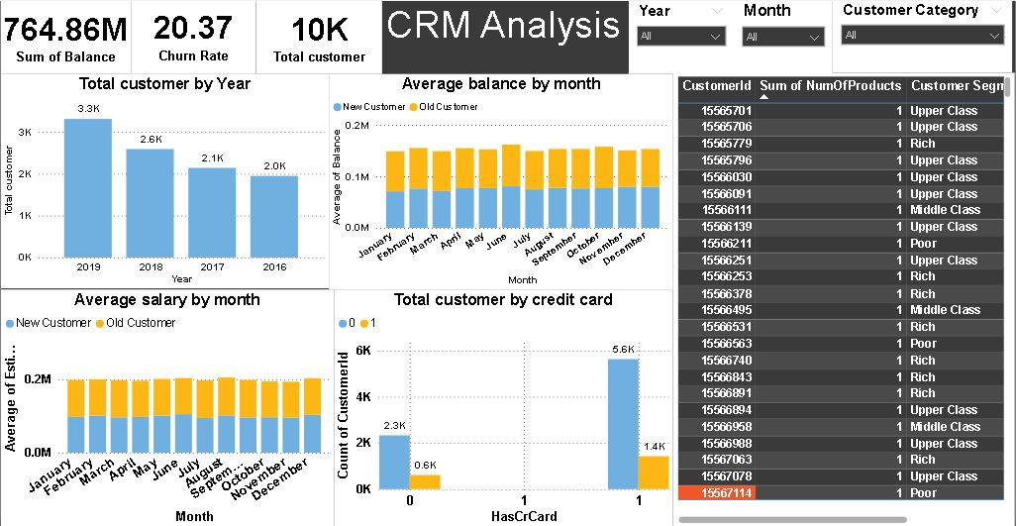
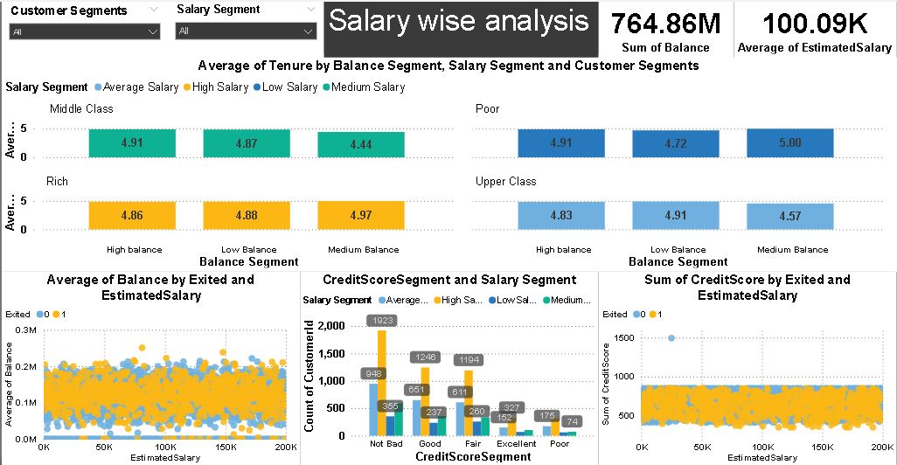
Dasboard

Slide 19


